Slide 1

CUSTOMER CHURN ANALYSIS
- By Allen Thomas

Slide 2
INTRODUCTION
Greetings to all who are viewing this. In this presentation, I am going to be discussing the document- Customer Churn Analysis. I'm going to be analysing what the primary factors influencing customer churn are, and if there are any specific patterns or correlations from the data. We will also try and understand how to improve the customer retention and increase profits.

Slide 3
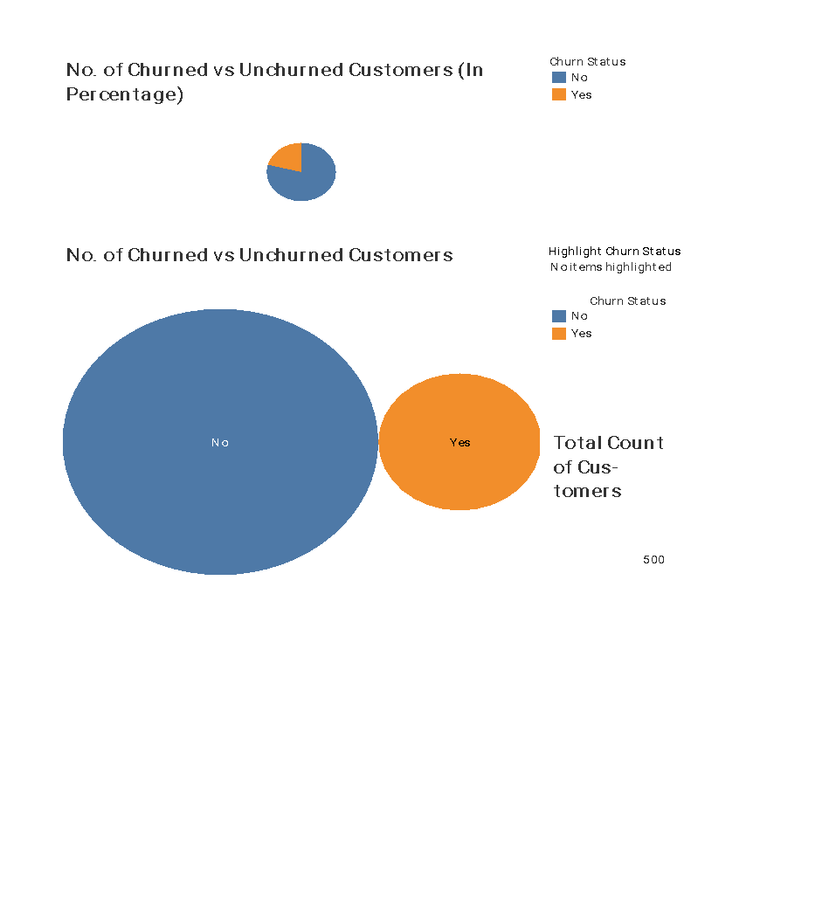
Churned Status Analysis
Firstly, we have on display Churned Status
Analysis. In the Churn status analysis, we have a pie chart which shows number of churned vs unchurned customers (in percentage). From this graph, we get the basic idea that 21% of all users dropped out from our service. That is, they are the churned customers. The remaining 79% are
still active users. The second graphic shows the actual number of Churned vs Unchurned
customers. It basically shows that out of 500
customers, 395 customers are still active users and 105 customers have churned out.

Slide 4
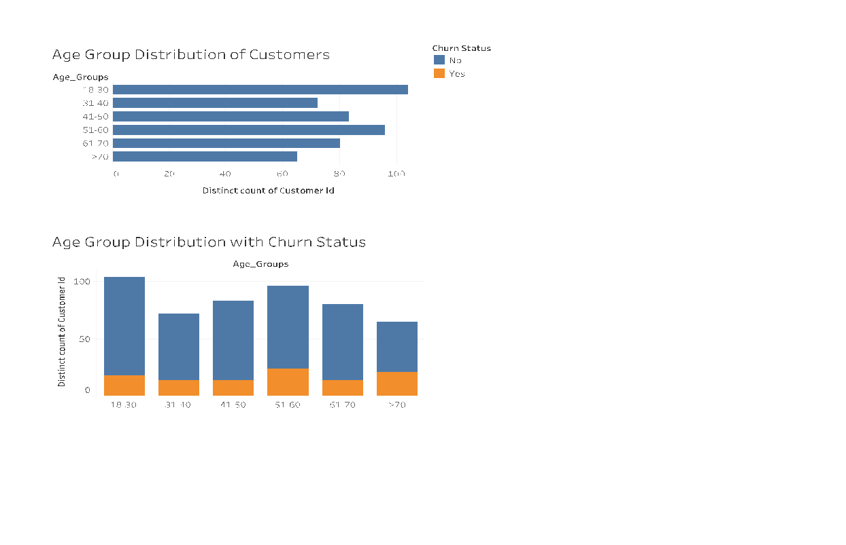
Customer Demographics Analysis- Age
In this dashboard, we can see the Customer Demographics Analysis. From this data, what we are trying to understand is whether there is any correlation between the churn rate and age group. I came to the conclusion that age groups above the age of 50 showed a higher churn rate. We have a total of 56% churn coming from the last 3 age categories. That is, from age 51 onwards, which is also 48% of the sample population.

Slide 5
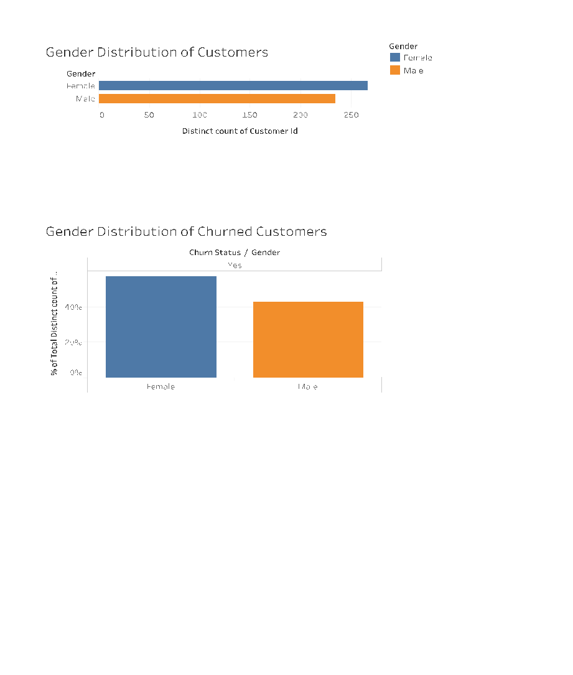
Customer Demographics Analysis- Gender
This dashboard shows Churn Analysis with respect to Gender. We can't see any alarming data, and the only inference is that more number of females use our Internet services as compared to males. And therefore, even the churn rate is higher in females.

Slide 6
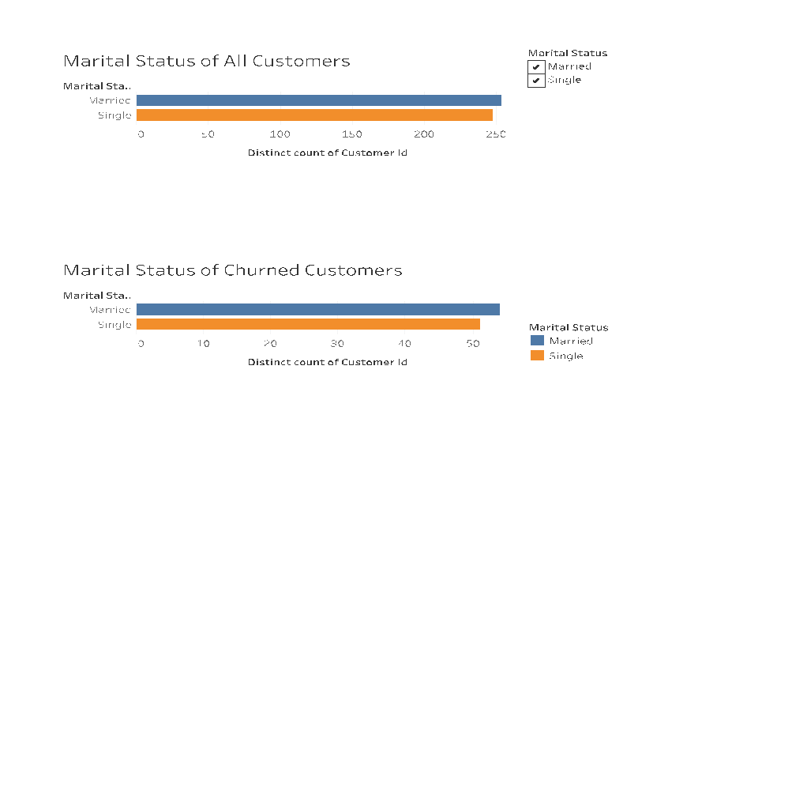
Customer Demographics Analysis- Marital Status
This dashboard shows Churn Analysis with respect to Marital Status. Similar to the last analysis, we can't see any alarming data, and the only inference is that Singles use our service lesser than Married Individuals.

Slide 7
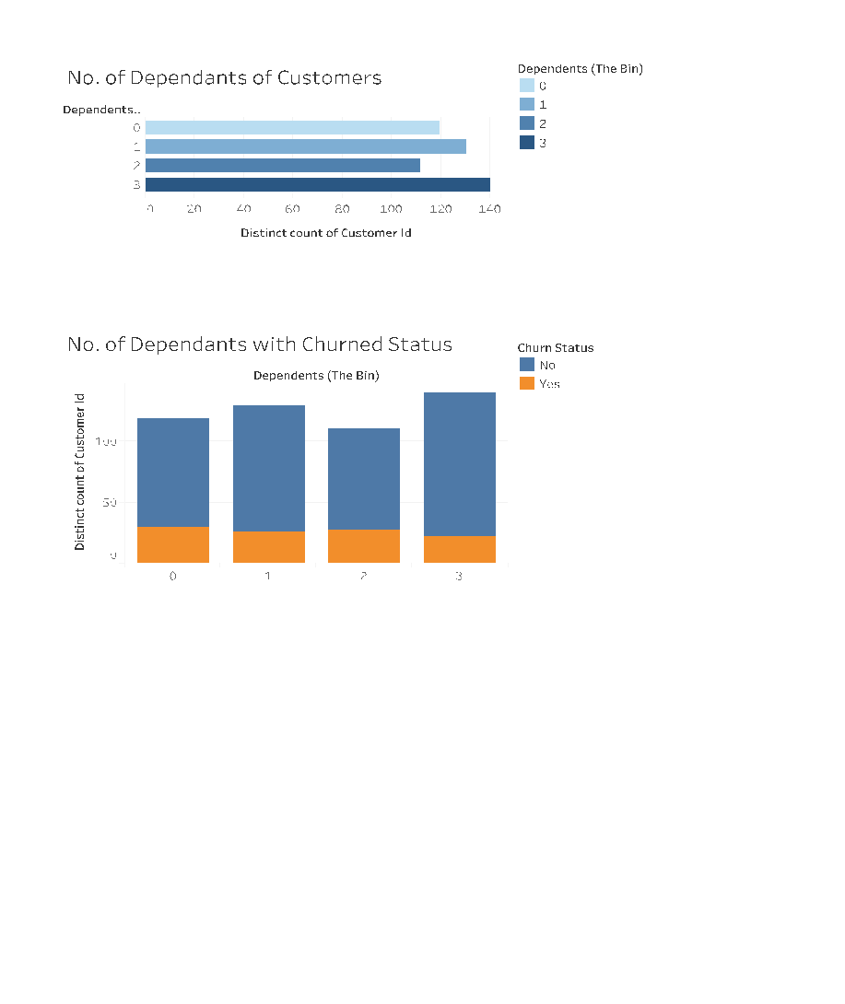
Customer Demographics Analysis- Dependent Count
This dashboard shows Churn Analysis with respect to the Number of Dependents of the customers. Here, as we can see in the image that customers with 0 dependents show a higher churn rate. However, customers with 2 dependents showed a higher churn rate than customers with 1 dependent, and the reason for this is not clear. The least change rate was displayed by customers with 3 dependents, as expected

Slide 8
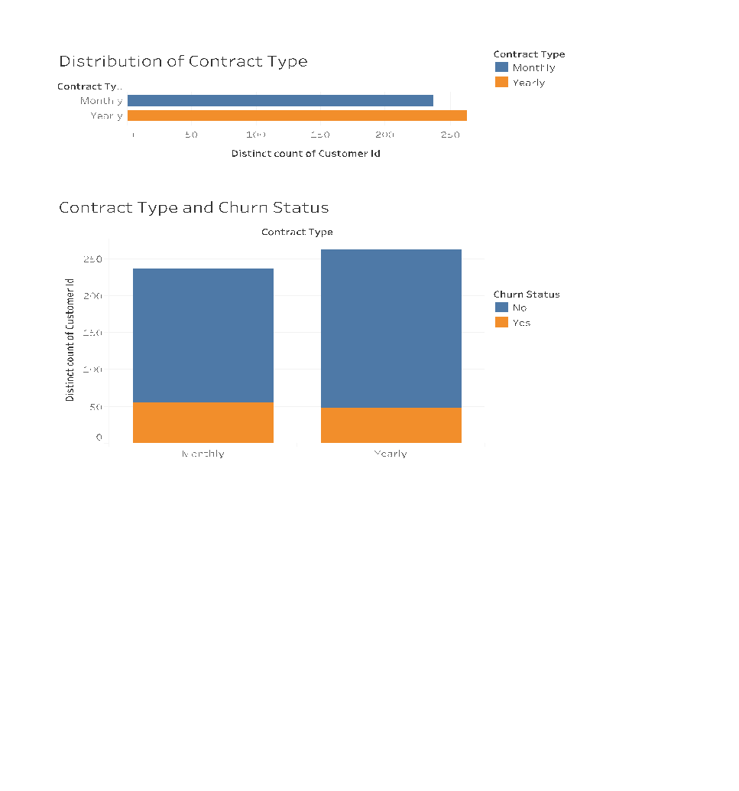
Contract Type Analysis
In this dashboard, we have Churn Analysis with respect to the Contract Type. That is, with respect to the 2 Contract Types, which are Monthly and Yearly. We can clearly see that monthly contracts are more prone to churn than yearly contracts. The churn rate is around 24% for monthly contracts, whereas it is only 19% for yearly contracts. Therefore, to increase our profits and revenue we can give more emphasis, Offers and marketing costs towards the Yearly contacts.

Slide 9
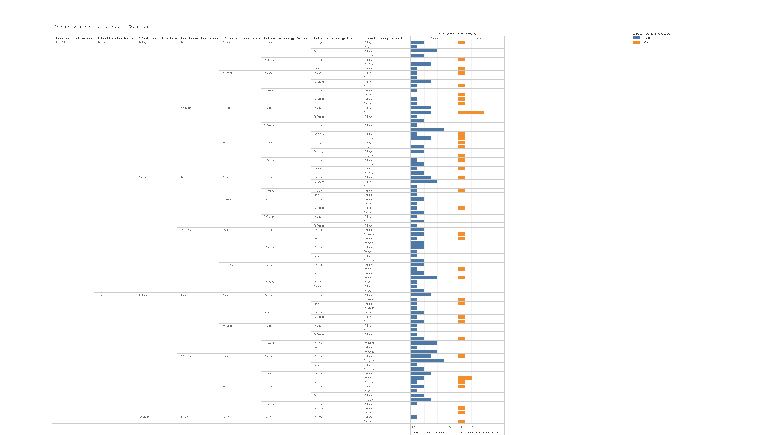
Service Usage Data
This Dashboard shows Churn Analysis with respect to the different Services’ Usage. This is basically shown for analysing the data of Churned and Unchurned Customers With the different services that they opted for. We will look into these services in more detail.

Slide 10
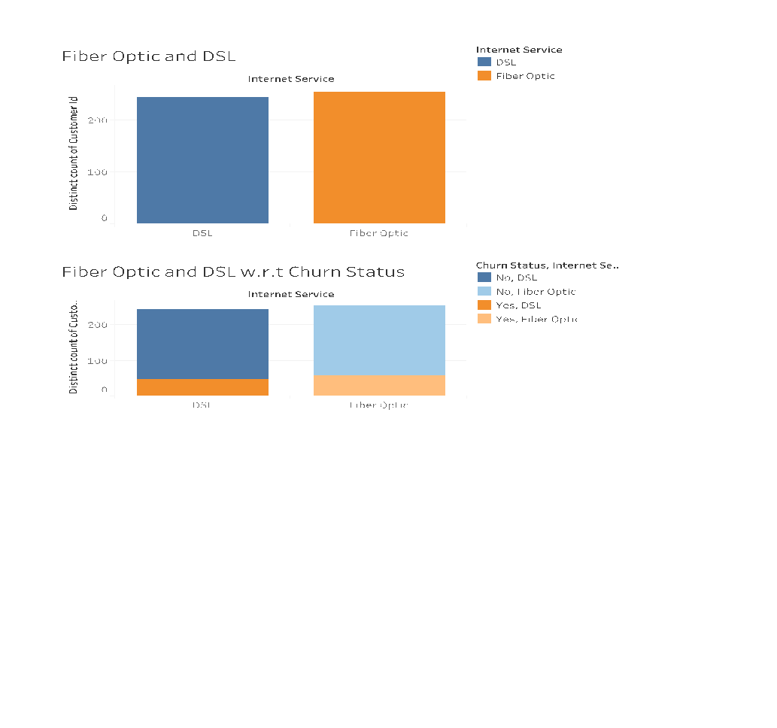
Fiber Optic vs DSL
This Dashboard shows The comparison between Fiber Optic and DSL. Here, we can see that Fiber Optic shows greater Churn rate than DSL. The churn rate in DSL is seen to be less than 19%, whereas that of Fiber Optic Is greater than 23%. Also, the number of customers using DSL is lesser than customers using fiber optic. So this is something the company can work on. For maximising profits, the company can invest more heavily in DSL and give less emphasis on fibre optic.

Slide 11
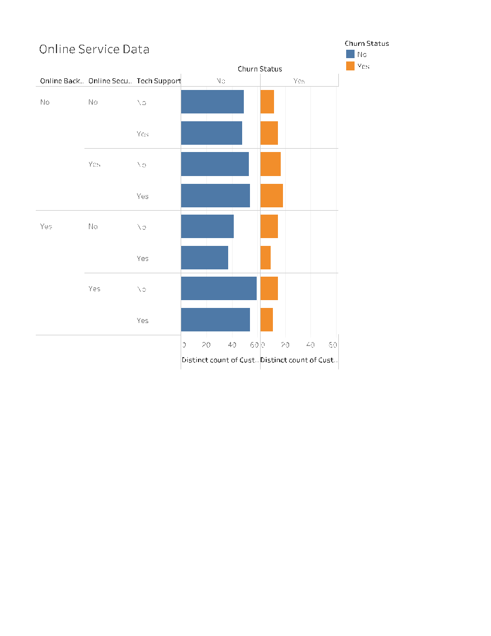
Online Service Analysis
This Dashboard shows Churn Analysis with respect to the Online Services. The Online Services refer to 3 services- tech support, online security and online backup. After visualising the Data, the first point to notice is that customers with no online backup have higher Churn rate than customers with online backup. Customers with no online backup had a churn rate of more than 56% of the total churn, whereas these customers with no online backup made up only around 41% of the total dataset. Therefore, we can infer that it is important to push the customers into taking this online backup option. At the same time, we can infer that online security doesn't seem to be that important since the customer churn rate it’s as high for customers with online security. We can see that customers with online security had a high churn rate of 55% of the total churn, whereas these customers with online security made up only around 44% of the dataset. Therefore, we can afford to invest less into online security as compared to online backup. Next, in the case of tech support churn rate is around 48% of the total churn, and the customers with tech support account for around 39% of the total dataset. So, we can invest big into tech support and online backup.

Slide 12
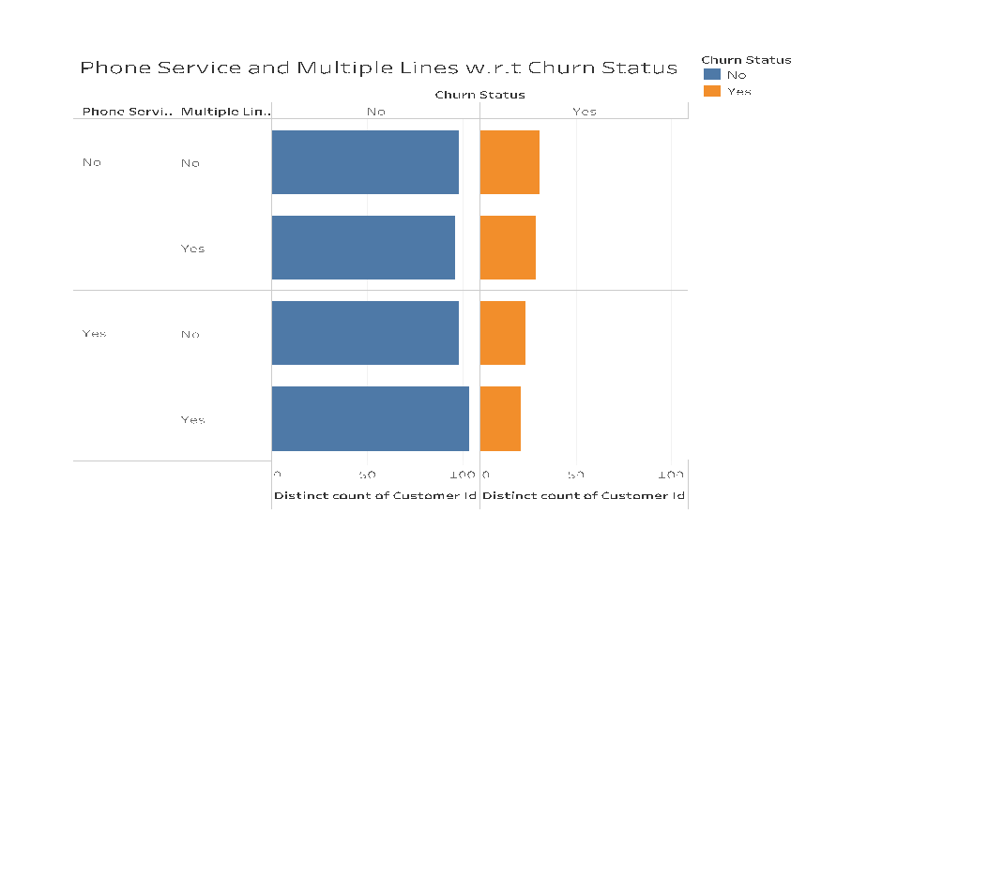
Phone Service vs Multiple Lines
Here, we are Analysing Phone Service and Multiple Lines with respect to the Churn Status. We basically find that both phone services and multiple lines are important extra services.

Slide 13
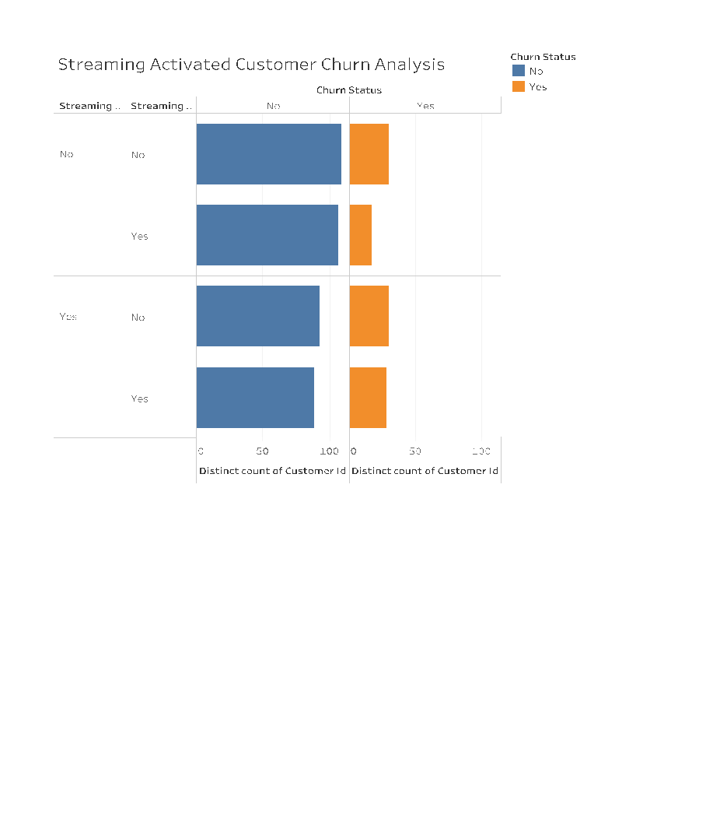
Churn Analysis for Streaming
This Dashboard shows Churn Analysis with respect to Streaming Services. In this particular visualization, we can see that there are 2 services- Streaming TV and Streaming Movies. We can see that streaming TV services have lower churn as compared to streaming movie services. By studying the 2 bar charts shown, I have come to the conclusion that we can get rid of streaming movies and focus on streaming TV. Try to give better offer for streaming TV, and try to drive the customer traffic towards streaming TV rather than streaming movies, because streaming TV seems to have lower churn rate.

Slide 14
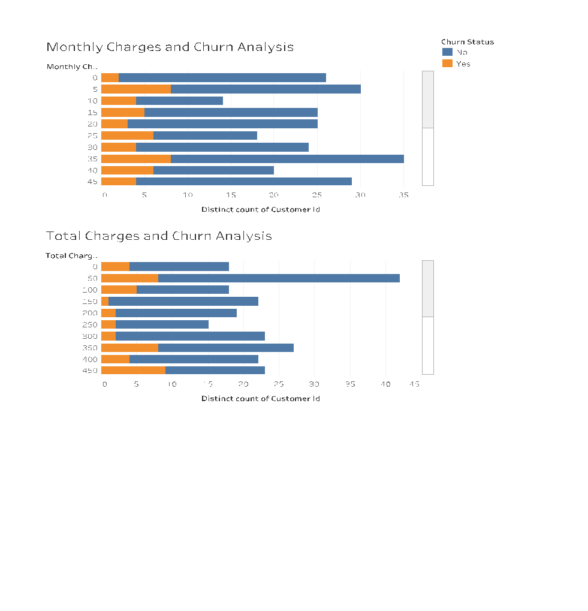
Charges and Churn Analysis
Finally, we come to the Churn Analysis with respect to Monthly and Yearly charges. Here, we can see that 58% of Churn comes from Yearly charges of $450 and higher. I.e., Only 42% of Churn from bottom(lower charges) 50% of customers. 77% of the Yearly Churn are belonging to the category of $350 and higher. Till $300, I.e., 32% of Total Customers show only 23% of churn. Therefore, it would be a good idea to give maximum offers and benefits for keeping the total bill upto $300, as much as possible. And, there is no real correlation in the monthly charges analysis.

Slide 15
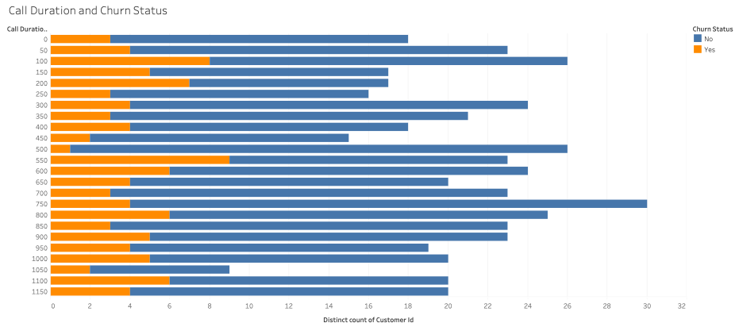
Call Duration and Churn Status
This is a visual of Call Duration vs No. of Customers, with Customer Churn Status in the 2 different color codes. There isn’t much learning in this graphic for increasing our sales. However, as a general rule of thumb, more Call Duration time can actually be a good thing.

Slide 16
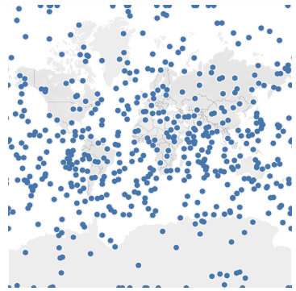
MAP ANALYSIS
Finally, this is the Map Analysis. There seems to be some error with the data due to which there are data points all around the globe, and even in the oceans.
Along with that, even Forecasting is not possible since there are no timelines given

Slide 17
CONCLUSION PAGE
I was asked about Forecasting, and I am not sure if I can do it because there is nothing with respect to date in this dataset, and if there is no timeline at all, I am not sure of how the Forecasting can be done.
THANK YOU, & Have a Nice Day ☺

